Slide 1
This is an example of how valuation results are presented
Fill in or replace the following tables with your own results
1
Notes:
1

Slide 2
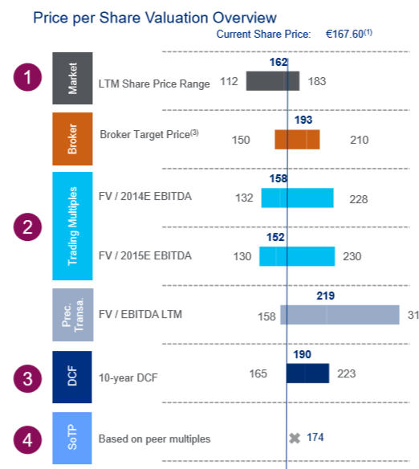
Football-Field
Overview of valuation results. The graph template can be found in the excel file.
2

Slide 3
Peer Group
Provide an overview of relevant peers and your reasoning why you chose any beyond the ones included in sources
Peers
Comparability to Traton SE
Relevance
3

Slide 4
Continental currently trades at a FV/EBITDA 2014E multiple of 7.9x and a P/E 2014 multiple of 12.1x, with FV/EBITDA slightly above peers and P/E below peers.
Multiples
Overview of multiples
Trading Multiples for Automotive Suppliers
Source: Company Information, Broker Research, Factset as of 26th August,
4

Slide 5
DCF
Financial forecasts used for DCF as well as sensitivity analysis
Fundamental valuation of Continental results in a FV of €46.7bn and an EV of €38.0bn considering a WACC of 10% and a perpetuity growth rate of 3%. Additional upside could be realized if synergies would be considered.
Financial Summary
Source: Company Information, Bloomberg, FactSet as of 26th August 2014.
5

Slide 6
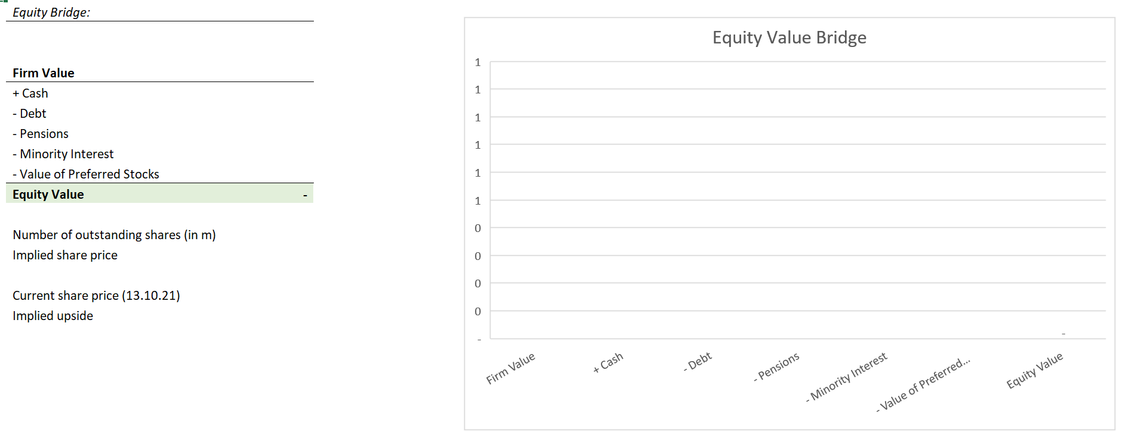
Equity Bridge
6

Slide 7
DCF Assumptions
Explain your DCF assumptions (Revenues, growth rates)
7

Slide 8
Appendix: AI Usage
If relevant: explain how you employed AI for the exercise
8

